Slide 1
CAPSTONE PROJECT
BANHMI PHUONG

Slide 2
I. Introduce
Problem description:
Banhmi Phuong is one of the most famous brand in Vietnam. Now, the brand has a plan to expand its business in Toronto. The first job is finding the most suitable place for its.

Slide 3
II. Data
The data used in this project is provided by Foursquare location data.
The data are grouped by landscape area, and each area included the information about this area and all information about restaurants, cafes, and stores which in this area.

Slide 4
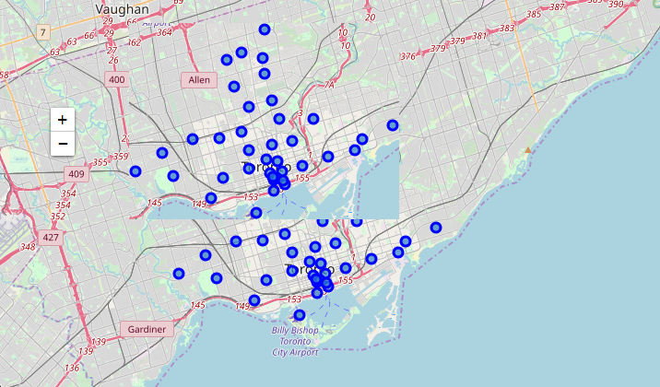
III. Explore
Toronto map

Slide 5
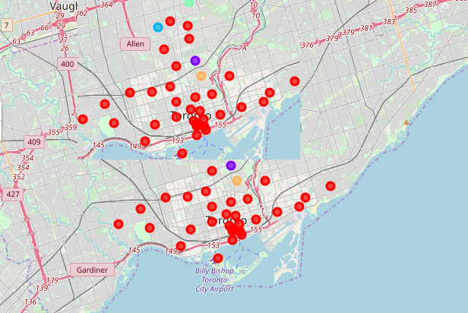
IV. Cluster Neighborhoods

